Slide 1

We’re STEAMED! A call for balancing technical instruction and disciplinary content in the digital humanities Christopher Church Katherine Hepworth
Notes:
We shall address with our examples of teaching digital humanities courses at the University of Nevada, Reno, equalizing the technical and the critical domain knowledge in the classroom has ramifications for what can be covered in the STEAM classroom, including limiting the content breadth and at times depth for space constraints, but it also marries for students essential 21-first century knowledge that is too frequently siloed at University campuses.

Slide 2
Overview
0:30

Slide 3
Overview Digital Natives?
0:30

Slide 4
Overview Digital Natives? STEAM
0:30

Slide 5
Overview Digital Natives? STEAM Two Course Examples
0:30

Slide 6
Overview Digital Natives? STEAM Two Course Examples Lessons Learned
0:30

Slide 7
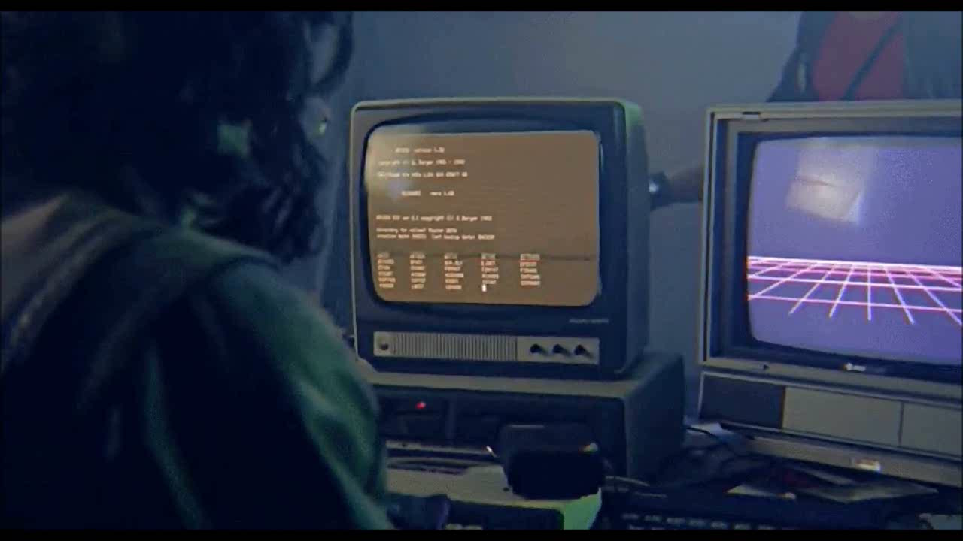
1:00

Slide 8

Myth of the Digital Native
1:30
Notes:
According to Neil Selwyn, from the Institute of Education at the University of London, the notion that young people and children are inherently more confident and capable in computerized that is, that they are “experts” or somehow native to the digital world—has held currency since the 1970s, long before Marc Prensky coined the term “digital native” in 2001. This idea has only gained more momentum over the years, shaping how we treat the next generation, both culturally and pedagogically. [1]
To some extent, we are all touched by the idea that since children were born into a world with computers, and since they have interacted with technology since essentially birth, they have necessarily become…
[1] Selwyn, Neil. "The digital native: myth and reality". Selwyn, Neil (2009) The Digital Native: Myth and Reality. ASLIB Proceedings, 61 (4). Pp. 364-379. ISSN 0001-253X

Slide 9
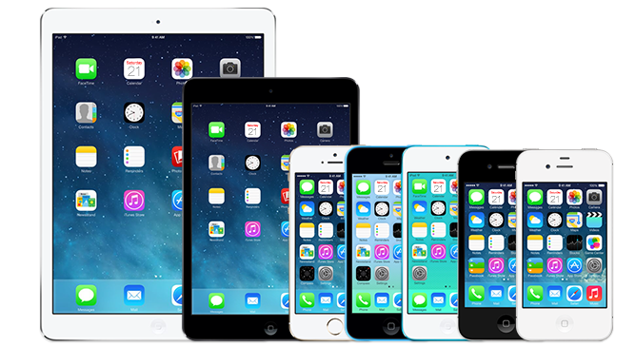
2:00
Notes:
However, the computing devices that students engage with are primarily content-consumption devices, used for watching movies or playing games, all at the tip of a finger. Touch an app, and the device handles the rest.
So children and students today do not use computing technology to create, but rather to consume content, and they do not merely achieve fluency with a device via osmosis.
To use an analogy: riding in a car does not make one able to drive one by dint of the hours ridden (if that were true, I could turn over my keys to my 6-year-old). And to follow the analogy, driving a car does not in-and-of itself qualify one to be a mechanic.
As Selywn (2009) states, “young people’s engagements with digital technologies are varied and often unspectacular – in stark contrast to popular portrayals of the digital native.” And he identifies what he calls “a misplaced technological and biological determinism that underpins current portrayals of children, young people and digital technology.”

Slide 10
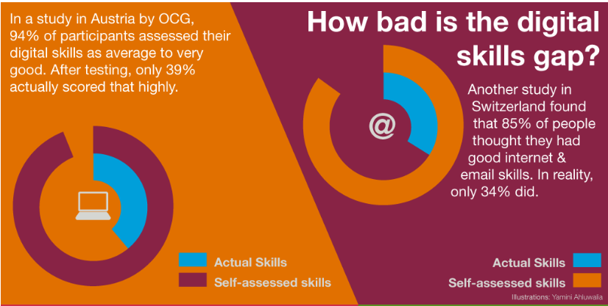

2:30
http://ecdl.org/policy-publications/digital-native-fallacy
Notes:
Further work by the European Computer Driving Licence organization (or ECDL) has further highlighted the dramatic gap between cultural perception and reality. And in this case, individuals themselves, as a result of this myth, have a grossly overestimated perception of their own technological ability.
As you can see, while 94% of survey participants in Austria felt they had average to very good digital skills, only 39% actually demonstrated such a skill level. Results were similar in Switzerland.

Slide 11
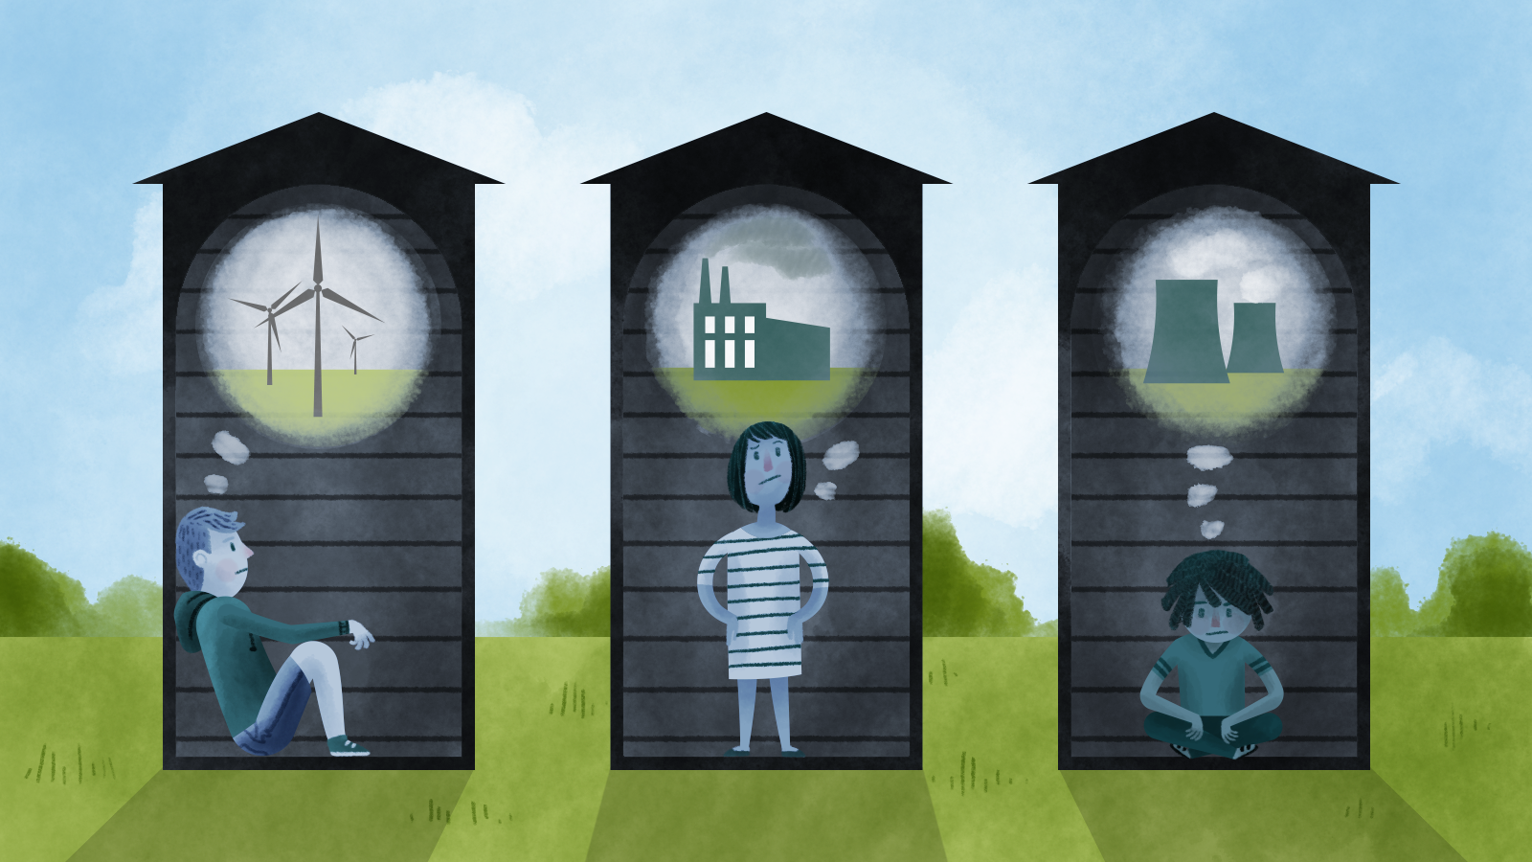


Teaching Model: STEAM
4:00
Notes:
To rectify this, we are proposing an integrative STEAM model that pulls together technical instruction with domain-area content, treating them as equal constitutive parts of the digital humanities classroom.

Slide 12
Teaching Model: STEAM Science
4:05

Slide 13
Teaching Model: STEAM Science Technology
4:05

Slide 14
Teaching Model: STEAM Science Technology Education
4:05

Slide 15
Teaching Model: STEAM Science Technology Education Art
4:05

Slide 16
Teaching Model: STEAM Science Technology Education Art Mathematics
4:05

Slide 17
Teaching Model: STEAM Started in 2006
4:10

Slide 18
Teaching Model: STEAM Started in 2006 Design incorporated in 2010
4:20

Slide 19
Teaching Model: STEAM Science Technology Education Art + Design
4:40

Slide 20
Two Courses
4:50

Slide 21
Two Courses HIST300a Digitizing History
4:55

Slide 22
Two Courses HIST300a Digitizing History JOUR/HIST308 Web Design for Social Engagement
5:00

Slide 23
Two Courses Project-based
5:05

Slide 24
Two Courses Project-based Service learning
5:10

Slide 25
Two Courses Project-based Service learning Interdisciplinary domain instruction
5:15

Slide 26
Two Courses Project-based Service learning Interdisciplinary domain instruction Domain instruction + technical instruction
5:20

Slide 27
Two Courses Project-based Service learning Interdisciplinary domain instruction Domain instruction + technical instruction = Critical Digital Humanities
5:25

Slide 28
Digitizing History
5:30
Notes:
HIST 300a teaches students how to produce web-based historical information themselves, giving them a critical eye to information on the internet and an understanding of how information (and misinformation) is disseminated online.
By combining a history course with digital skills, HIST 300a teaches evidence-based argumentation alongside the tools used to create the digital ephemera and content we consume on a daily basis.
To do so, the course is project-based. It’s not structured in the same way that most CS or IT courses are, where you would typically go to learn these skills and which teach through a series of exercises and problem sets. Instead, students choose a term-length research topic that takes them into the University Archives
The classroom is flipped, so that the vast majority of class time is spent in student-centered lab work, hitting on application through evaluation in Bloom’s taxonomy.
The entire class takes place in our library, so students work under the direct supervision of myself, as well as a team of library faculty and staff. There, students have access to video production equipment, computers, a sound-recording room for voice overs, and the library’s special collections and archives.
Though I do provide short introductory lectures to key concepts, students essentially learn by doing. In our 16-week class, almost half of the class periods are workshop days during which students plug through their project, hit obstacles, and have us on hand to instruct on a one-on-one basis.
Most of what they do is trial-and-error, and the experiential nature of it makes it stick. Two years ago, we had one student continue her project after she graduated for a local museum in Tahoe.
One caveat is that this course takes a lot of resources, and we have domain-specific personnel to assist students.
Without such resources, digital project-based instruction is still do-able, but I would encourage you the scale back heavily the expectations of what students can do with the digital technologies and ramp up the amount of time you devote to in-class workshop time. At THATCamps and conferences, I hear a consistent refrain among instructors of these types of classes: students needed more lab time under my supervision that I would have ever thought!

Slide 29
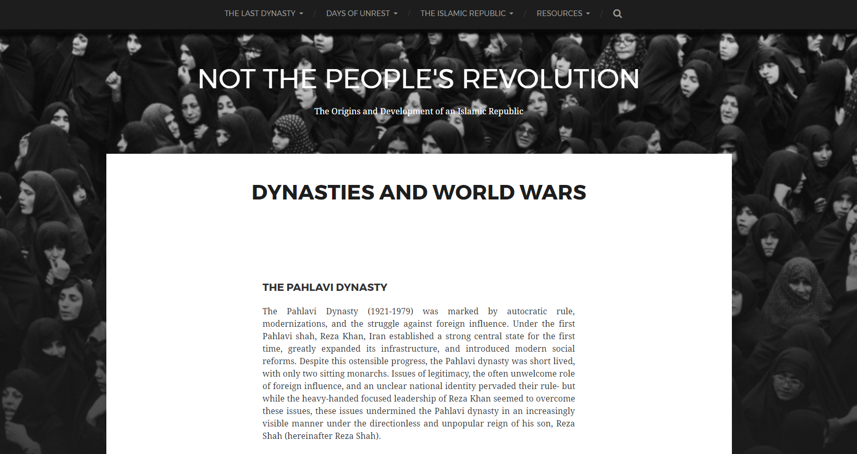
http://digitalhistory.acs.unr.edu/hist300a/sp2016/iranianrevolution/
6:00
Notes:
Now that I’ve explained to you the motivations and research underpinning the class, I’d like to close with an example of student output.
This student examined the role of popular perception in the 1979 Islamic Revolution in Iran, arguing that frustration with autocracy and a hope for a better future led many to support a regime that would tragically bring neither.

Slide 30
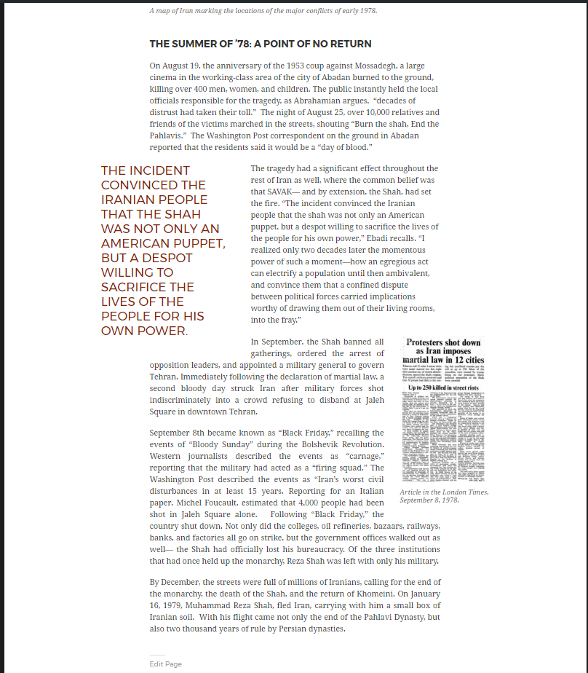
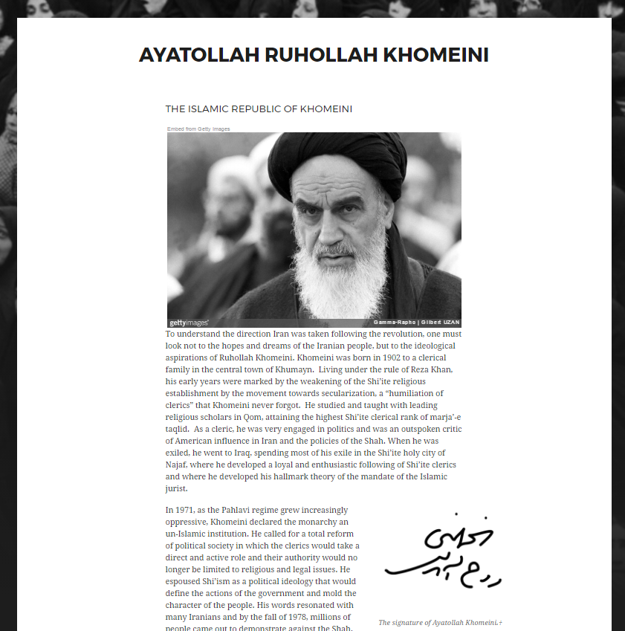
6:30
Notes:
She integrated primary source materials alongside her textual narrative, giving thought to page layout, media placement, and stylistics.
Since I’m short on time, I wanted to show you a brief clip from the introductory video she made for her project (the first 90 seconds of her 5-minute video).

Slide 31
Web Design for Social Engagement
7:30

Slide 32

8:00

Slide 33

9:00

Slide 34
Lessons Learned
9:30

Slide 35
Lessons Learned Scaffolding becomes more critical
10:00

Slide 36
Lessons Learned Scaffolding becomes more critical Quadruple instruction preparation time
11:00

Slide 37
Lessons Learned Scaffolding becomes more critical Quadruple instruction preparation time Double in-classroom tech instruction time
12:00

Slide 38
Lessons Learned Scaffolding becomes more critical Quadruple instruction preparation time Double in-classroom tech instruction time Halve your domain knowledge instruction time
13:00

Slide 39
Lessons Learned Scaffolding becomes more critical Quadruple instruction preparation time Double in-classroom tech instruction time Halve your domain knowledge instruction Incorporating tech instruction amplifies domain instructions
14:00

Slide 40

Thank you
15:00
Notes:
In conclusion
That students just get technology no more so than they just get history. That the widespread assumption that students are digital natives for whom technology comes second-nature harms more than it helps.
Consequently, that digital literacy instruction in the content area requires far more time than it may seem at first glance, and that flipping the classroom is precisely the way to give students the hands-on instruction hey need.
And finally, that students benefit from digital project-based instruction precisely because it teaches critical thinking alongside the digital literacy skills so essential to our modern world. And that they can create fantastic projects under these conditions!

